Slide 1


Tight Bounds for Adversarially Robust Streams and Sliding Windows via Difference Estimators
Samson Zhou
(Based on work joint with David P. Woodruff)

Slide 2
Background
Post-doc at Carnegie Mellon
PhD in Computer Science from Purdue
Bachelors in Math, Computer Science from MIT
Research areas: Security and Privacy, Data Science, Sublinear Algorithms
Notes:
Let’s start by breaking down each of the terms in the title. To understand the sliding window model, we first have to understand the streaming model of computation, in which elements of an underlying data set S, arrive sequentially and the goal is to evaluate or approximate some given function on this dataset, using space sublinear in S. In the sliding window model, only the W most recent updates form the underlying data set

Slide 3
Recent Work on Security and Privacy
Private Data Stream Analysis for Universal Symmetric Norm Estimation (FORC 2022)
On the Security of Proofs of Sequential Work in a Post-Quantum World (ITC 2021)
Approximating Cumulative Pebbling Cost is Unique Games Hard (ITCS 2020)
Computationally Data-Independent Memory Hard Functions (ITCS 2020)
Data-Independent Memory Hard Functions: New Attacks and Stronger Constructions (CRYPTO 2019)
Bandwidth-Hard Functions: Reductions and Lower Bounds (CCS 2018)
On the Economics of Offline Password Cracking (Security and Privacy 2018)
Notes:
Let’s start by breaking down each of the terms in the title. To understand the sliding window model, we first have to understand the streaming model of computation, in which elements of an underlying data set S, arrive sequentially and the goal is to evaluate or approximate some given function on this dataset, using space sublinear in S. In the sliding window model, only the W most recent updates form the underlying data set

Slide 4
Recent Work on Data Science
Learning-Augmented k-means Clustering (ICLR 2022)
Fast Regression for Structured Inputs (ICLR 2022)
New Coresets for Projective Clustering and Applications (AISTATS 2022)
Dimensionality Reduction for Wasserstein Barycenter (NeurIPS 2021)
Learning a Latent Simplex in Input Sparsity Time (ICLR 2021)
Near Optimal Linear Algebra in the Online and Sliding Window Models (FOCS 2020)
Data-Independent Neural Pruning via Coresets (ICLR 2020)
Adversarially Robust Submodular Maximization under Knapsack Constraints (KDD 2019)
Notes:
Let’s start by breaking down each of the terms in the title. To understand the sliding window model, we first have to understand the streaming model of computation, in which elements of an underlying data set S, arrive sequentially and the goal is to evaluate or approximate some given function on this dataset, using space sublinear in S. In the sliding window model, only the W most recent updates form the underlying data set

Slide 5
Recent Work on Sublinear Algorithms
Memory Bounds for the Experts Problem (STOC 2022)
The White-Box Adversarial Data Stream Model (PODS 2022)
Truly Perfect Samplers for Data Streams and Sliding Windows (PODS 2022)
Noisy Boolean Hidden Matching with Applications (ITCS 2022)
Adversarial Robustness of Streaming Algorithms through Importance Sampling (NeurIPS 2021)
Tight Bounds for Adversarially Robust Streams and Sliding Windows via Difference Estimators (FOCS 2021)
Separations for Estimating Large Frequency Moments on Data Streams (ICALP 2021)
Non-Adaptive Adaptive Sampling on Turnstile Streams (STOC 2020)
Notes:
Let’s start by breaking down each of the terms in the title. To understand the sliding window model, we first have to understand the streaming model of computation, in which elements of an underlying data set S, arrive sequentially and the goal is to evaluate or approximate some given function on this dataset, using space sublinear in S. In the sliding window model, only the W most recent updates form the underlying data set

Slide 6

Model #1: Streaming Model
Input: Elements of an underlying data set $S$, which arrives sequentially
Output: Evaluation (or approximation) of a given function
Goal: Use space sublinear in the size $m$of the input $S$
1 0 1 1 1 0 0 1
Notes:
Let’s start by breaking down each of the terms in the title. To understand the sliding window model, we first have to understand the streaming model of computation, in which elements of an underlying data set S, arrive sequentially and the goal is to evaluate or approximate some given function on this dataset, using space sublinear in S. In the sliding window model, only the W most recent updates form the underlying data set

Slide 7
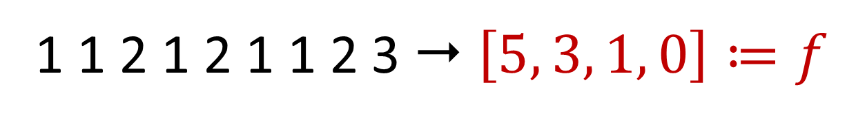

Heavy-Hitters
Given a set $S$ of $m$ elements from $[n]$, let $f_{i}$ be the frequency of element $i$. (How often it appears)
1 1 2 1 2 1 1 2 3  $\left[5, 3, 1, 0\right]≔f$

Slide 8
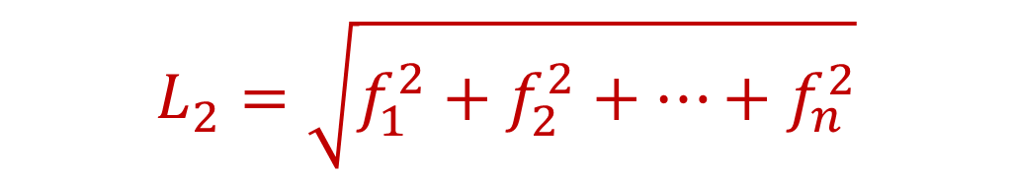
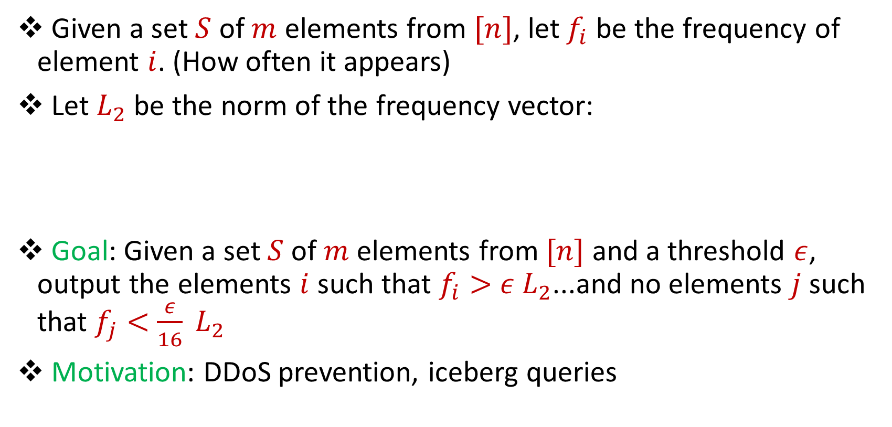
Heavy-Hitters
Given a set $S$ of $m$ elements from $[n]$, let $f_{i}$ be the frequency of element $i$. (How often it appears)
Let $L_{2}$ be the norm of the frequency vector:
Goal: Given a set $S$ of $m$ elements from $[n]$ and a threshold $ε$, output the elements $i$ such that $f_{i}>$ $ε L_{2}$...and no elements $j$ such that $f_{j}<$ $\frac{ε}{16} L_{2}$
Motivation: DDoS prevention, iceberg queries
$$L_{2}=\sqrt{f_{1}^{2}+f_{2}^{2}+…+f_{n}^{2}}$$

Slide 9
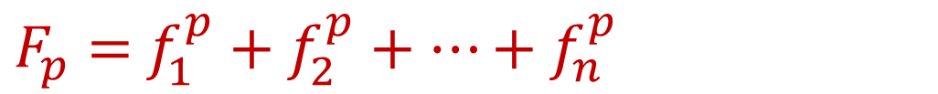
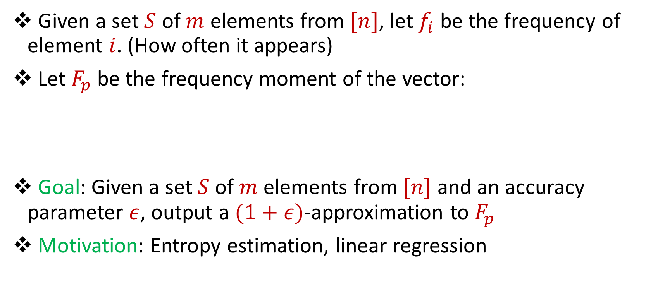
Frequency Moments
Given a set $S$ of $m$ elements from $[n]$, let $f_{i}$ be the frequency of element $i$. (How often it appears)
Let $F_{p}$ be the frequency moment of the vector:
Goal: Given a set $S$ of $m$ elements from $[n]$ and an accuracy parameter $ε$, output a $(1+ε)$-approximation to $F_{p}$
Motivation: Entropy estimation, linear regression
$F_{p}=$ $f_{1}^{p}+f_{2}^{p}+…+f_{n}^{p}$

Slide 10
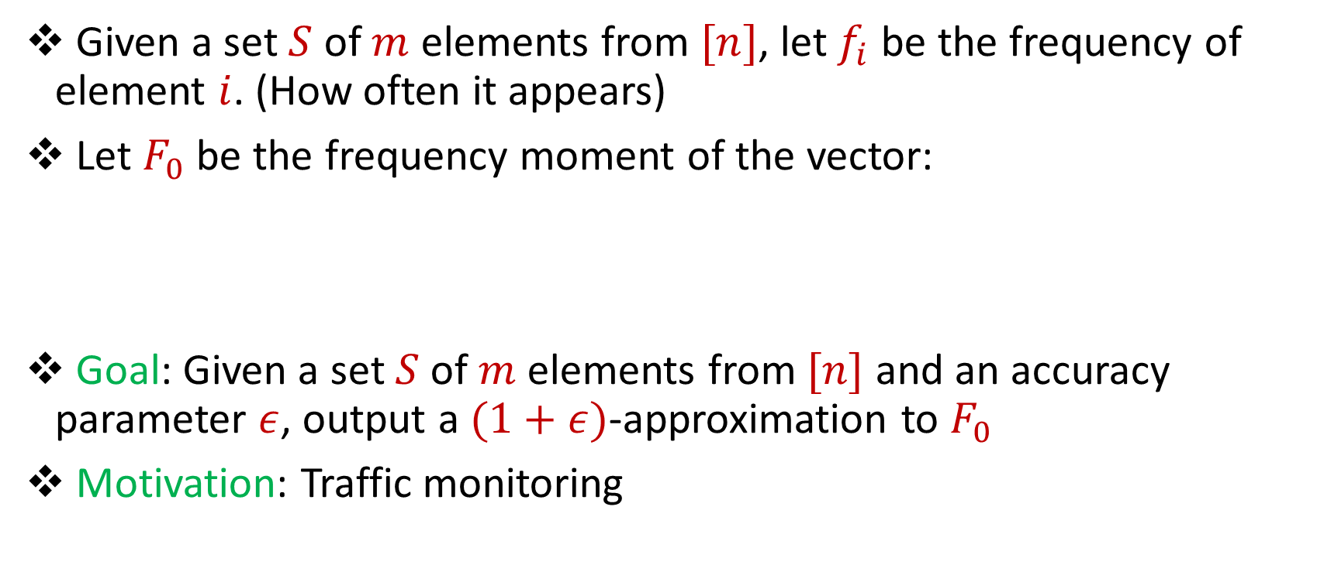
Distinct Elements
Given a set $S$ of $m$ elements from $[n]$, let $f_{i}$ be the frequency of element $i$. (How often it appears)
Let $F_{0}$ be the frequency moment of the vector:
Goal: Given a set $S$ of $m$ elements from $[n]$ and an accuracy parameter $ε$, output a $(1+ε)$-approximation to $F_{0}$
Motivation: Traffic monitoring
$F_{0}=$ $|\{i :f_{i}≠0\}|$

Slide 11
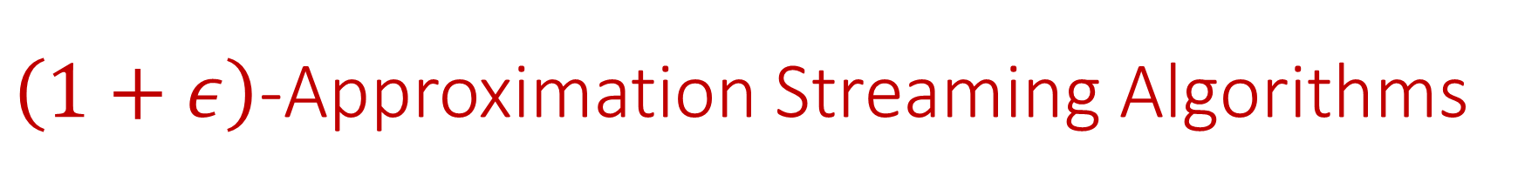
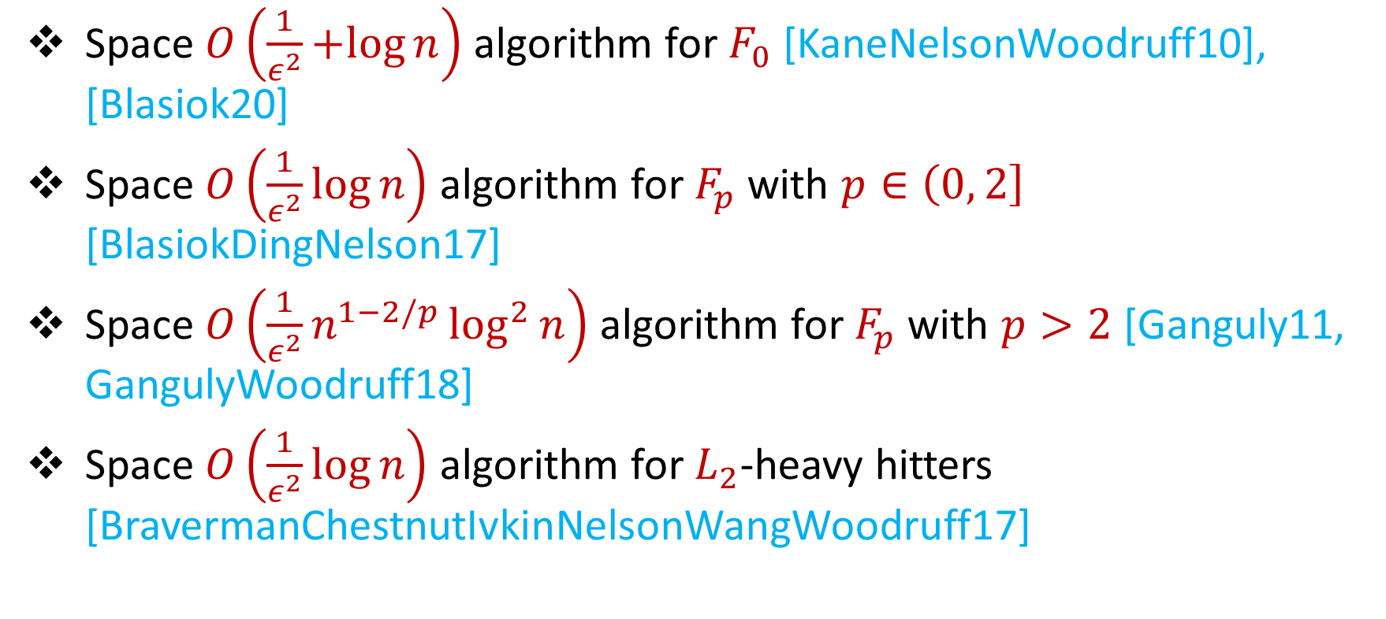
$\left(1+ε\right)$-Approximation Streaming Algorithms
Space $O\left(\frac{1}{ε^{2}}+log{n}\right)$ algorithm for $F_{0}$ [KaneNelsonWoodruff10], [Blasiok20]
Space $O\left(\frac{1}{ε^{2}}\log{n}\right)$ algorithm for $F_{p}$ with $p∈\left(0, 2\right]$ [BlasiokDingNelson17]
Space $O\left(\frac{1}{ε^{2}}n^{1−2/p}\log^{2}{n}\right)$ algorithm for $F_{p}$ with $p>2$ [Ganguly11, GangulyWoodruff18]
Space $O\left(\frac{1}{ε^{2}}\log{n}\right)$ algorithm for $L_{2}$-heavy hitters [BravermanChestnutIvkinNelsonWangWoodruff17]

Slide 12



Model #2: Adversarially Robust Streaming
Input: Elements of an underlying data set $S$, which arrives sequentially and adversarially
Output: Evaluation (or approximation) of a given function
Goal: Use space sublinear in the size $m$of the input $S$
1
1
Notes:
Let’s start by breaking down each of the terms in the title. To understand the sliding window model, we first have to understand the streaming model of computation, in which elements of an underlying data set S, arrive sequentially and the goal is to evaluate or approximate some given function on this dataset, using space sublinear in S. In the sliding window model, only the W most recent updates form the underlying data set

Slide 13
Model #2: Adversarially Robust Streaming
Input: Elements of an underlying data set $S$, which arrives sequentially and adversarially
Output: Evaluation (or approximation) of a given function
Goal: Use space sublinear in the size $m$of the input $S$
10
1
Notes:
Let’s start by breaking down each of the terms in the title. To understand the sliding window model, we first have to understand the streaming model of computation, in which elements of an underlying data set S, arrive sequentially and the goal is to evaluate or approximate some given function on this dataset, using space sublinear in S. In the sliding window model, only the W most recent updates form the underlying data set

Slide 14
Model #2: Adversarially Robust Streaming
Input: Elements of an underlying data set $S$, which arrives sequentially and adversarially
Output: Evaluation (or approximation) of a given function
Goal: Use space sublinear in the size $m$of the input $S$
101
2
Notes:
Let’s start by breaking down each of the terms in the title. To understand the sliding window model, we first have to understand the streaming model of computation, in which elements of an underlying data set S, arrive sequentially and the goal is to evaluate or approximate some given function on this dataset, using space sublinear in S. In the sliding window model, only the W most recent updates form the underlying data set

Slide 15
Model #2: Adversarially Robust Streaming
Input: Elements of an underlying data set $S$, which arrives sequentially and adversarially
Output: Evaluation (or approximation) of a given function
Goal: Use space sublinear in the size $m$of the input $S$
1010
3
Notes:
Let’s start by breaking down each of the terms in the title. To understand the sliding window model, we first have to understand the streaming model of computation, in which elements of an underlying data set S, arrive sequentially and the goal is to evaluate or approximate some given function on this dataset, using space sublinear in S. In the sliding window model, only the W most recent updates form the underlying data set

Slide 16

Model #2: Adversarially Robust Streaming
Input: Elements of an underlying data set $S$, which arrives sequentially and adversarially
Output: Evaluation (or approximation) of a given function
Goal: Use space sublinear in the size $m$of the input $S$
1010
3
Notes:
Let’s start by breaking down each of the terms in the title. To understand the sliding window model, we first have to understand the streaming model of computation, in which elements of an underlying data set S, arrive sequentially and the goal is to evaluate or approximate some given function on this dataset, using space sublinear in S. In the sliding window model, only the W most recent updates form the underlying data set

Slide 17
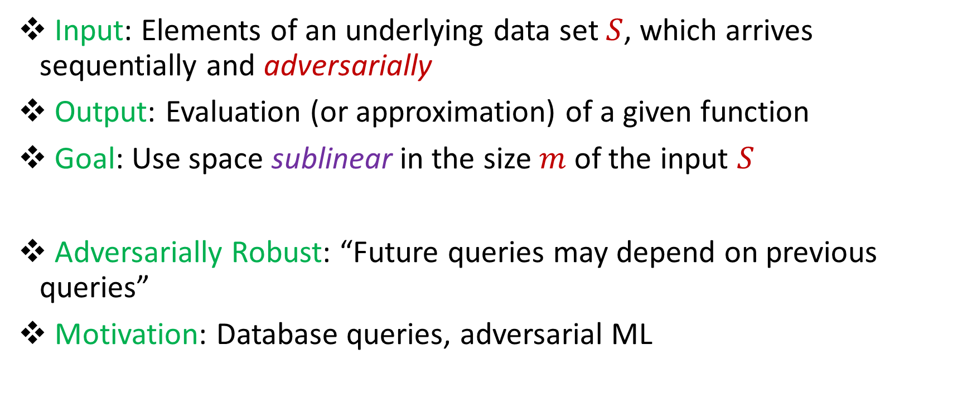
Model #2: Adversarially Robust Streaming
Input: Elements of an underlying data set $S$, which arrives sequentially and adversarially
Output: Evaluation (or approximation) of a given function
Goal: Use space sublinear in the size $m$of the input $S$
Adversarially Robust: “Future queries may depend on previous queries”
Motivation: Database queries, adversarial ML
Notes:
Let’s start by breaking down each of the terms in the title. To understand the sliding window model, we first have to understand the streaming model of computation, in which elements of an underlying data set S, arrive sequentially and the goal is to evaluate or approximate some given function on this dataset, using space sublinear in S. In the sliding window model, only the W most recent updates form the underlying data set

Slide 18
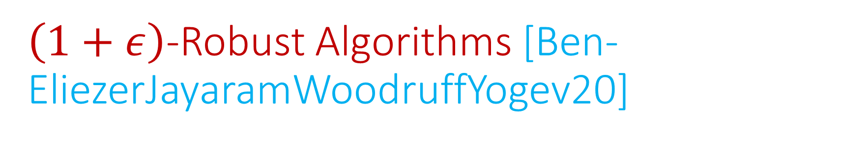
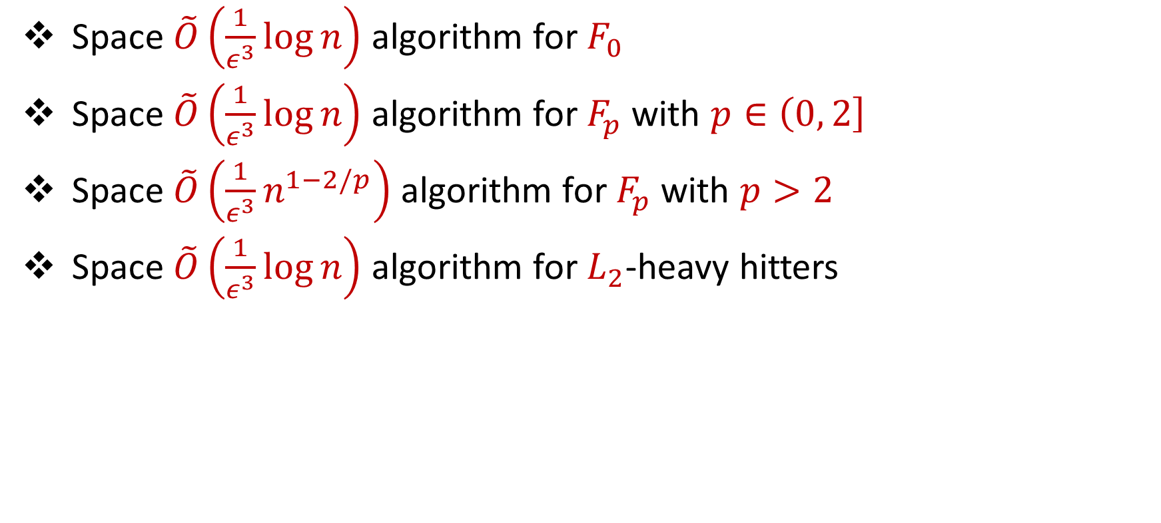
$\left(1+ε\right)$-Robust Algorithms [Ben-EliezerJayaramWoodruffYogev20]
Space $\tilde{O}\left(\frac{1}{ε^{3}}\log{n}\right)$ algorithm for $F_{0}$
Space $\tilde{O}\left(\frac{1}{ε^{3}}\log{n}\right)$ algorithm for $F_{p}$ with $p∈\left(0, 2\right]$
Space $\tilde{O}\left(\frac{1}{ε^{3}}n^{1−2/p}\right)$ algorithm for $F_{p}$ with $p>2$
Space $\tilde{O}\left(\frac{1}{ε^{3}}\log{n}\right)$ algorithm for $L_{2}$-heavy hitters
“A general framework that loses* nothing in $n$ and only $\frac{1}{ε}$ ”

Slide 19

“What’s an epsilon between friends?
Statista: $∼300B$ ${∼2}^{38}$ e-mails sent per day
Accuracy: $ε=0.01$
Since $\frac{1}{ε}>log n$, we should care about $\frac{1}{ε}$ factors!

Slide 20
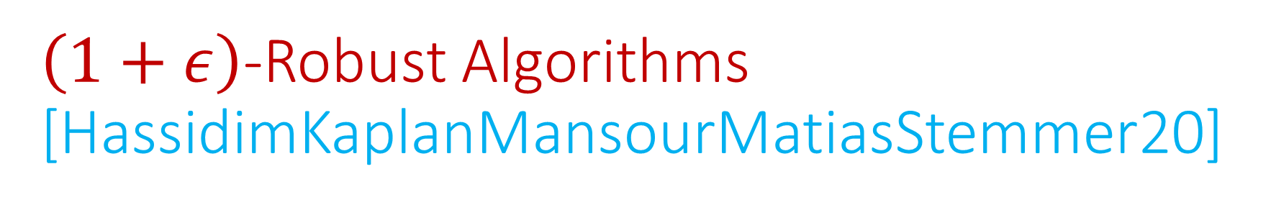
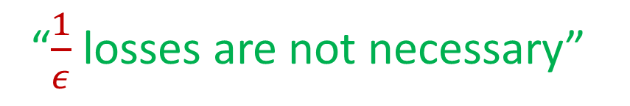
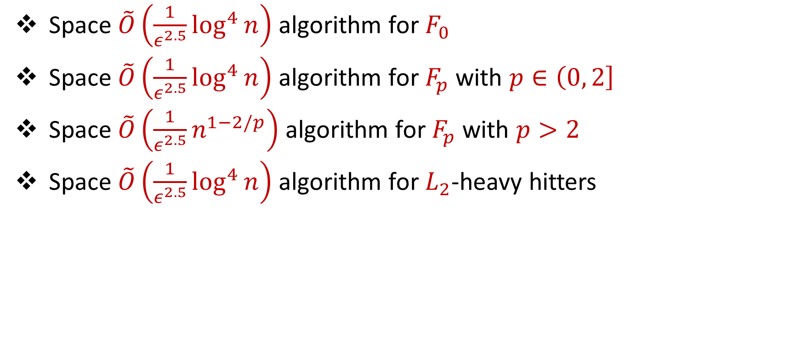
$\left(1+ε\right)$-Robust Algorithms [HassidimKaplanMansourMatiasStemmer20]
Space $\tilde{O}\left(\frac{1}{ε^{2.5}}\log^{4}{n}\right)$ algorithm for $F_{0}$
Space $\tilde{O}\left(\frac{1}{ε^{2.5}}\log^{4}{n}\right)$ algorithm for $F_{p}$ with $p∈\left(0, 2\right]$
Space $\tilde{O}\left(\frac{1}{ε^{2.5}}n^{1−2/p}\right)$ algorithm for $F_{p}$ with $p>2$
Space $\tilde{O}\left(\frac{1}{ε^{2.5}}\log^{4}{n}\right)$ algorithm for $L_{2}$-heavy hitters
“$\frac{1}{ε}$ losses are not necessary”

Slide 21

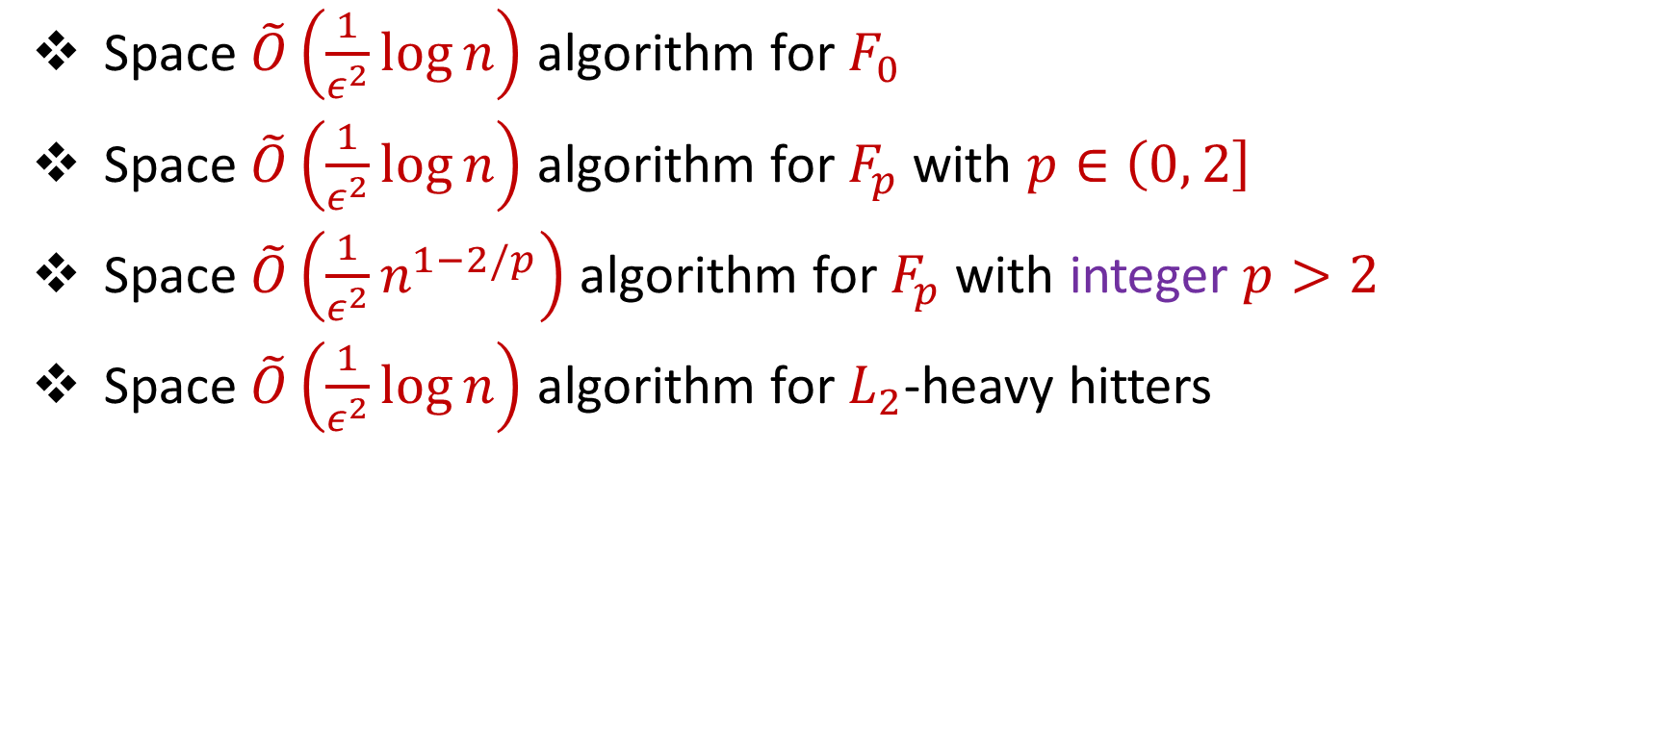
Our Results: $\left(1+ε\right)$-Robust Algorithms
Space $\tilde{O}\left(\frac{1}{ε^{2}}\log{n}\right)$ algorithm for $F_{0}$
Space $\tilde{O}\left(\frac{1}{ε^{2}}\log{n}\right)$ algorithm for $F_{p}$ with $p∈\left(0, 2\right]$
Space $\tilde{O}\left(\frac{1}{ε^{2}}n^{1−2/p}\right)$ algorithm for $F_{p}$ with integer $p>2$
Space $\tilde{O}\left(\frac{1}{ε^{2}}\log{n}\right)$ algorithm for $L_{2}$-heavy hitters
“No losses* are necessary!”

Slide 22
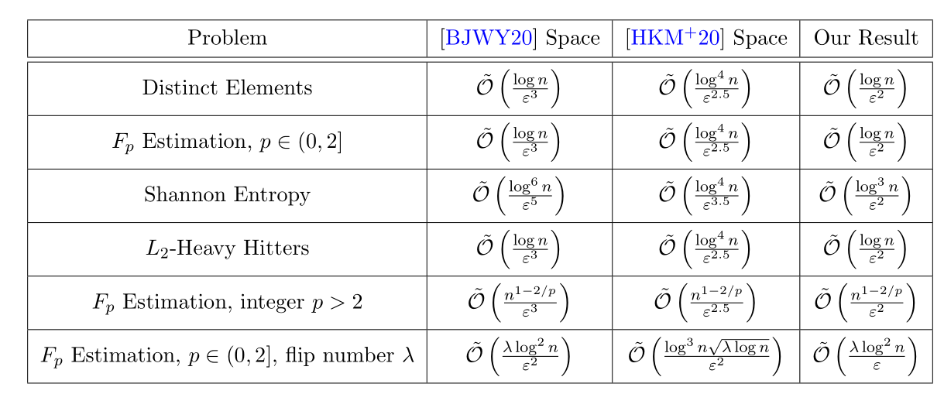
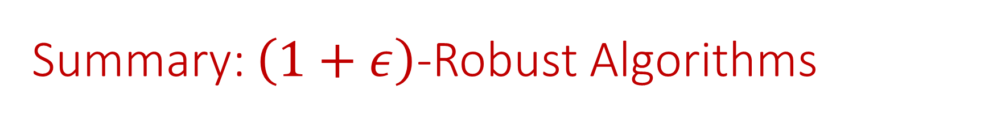
Summary: $\left(1+ε\right)$-Robust Algorithms

Slide 23
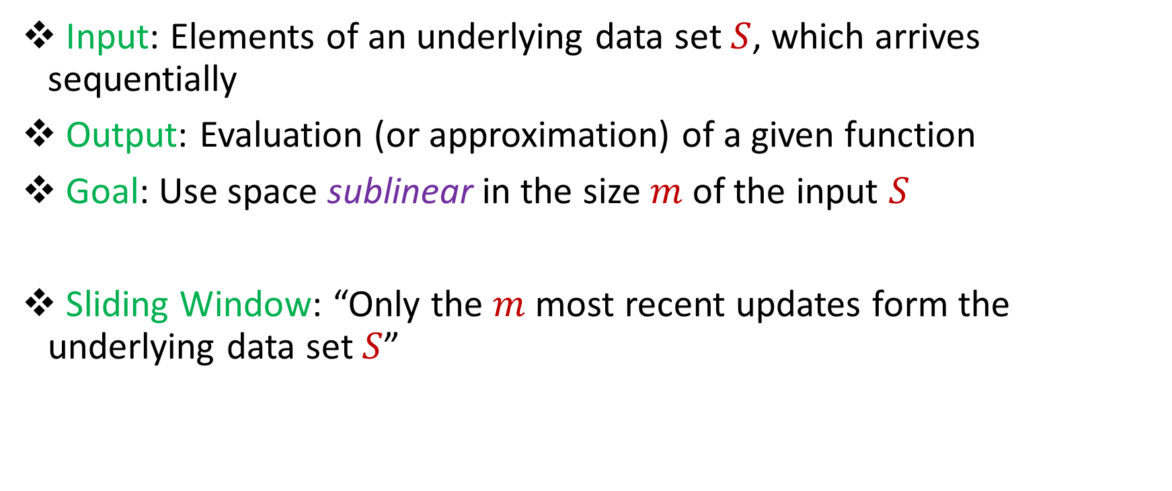
Model #3: Sliding Window Model
Input: Elements of an underlying data set $S$, which arrives sequentially
Output: Evaluation (or approximation) of a given function
Goal: Use space sublinear in the size $m$of the input $S$
Sliding Window: “Only the $m$ most recent updates form the underlying data set $S$”
1 0 1 1 1 0 0 1
Notes:
Let’s start by breaking down each of the terms in the title. To understand the sliding window model, we first have to understand the streaming model of computation, in which elements of an underlying data set S, arrive sequentially and the goal is to evaluate or approximate some given function on this dataset, using space sublinear in S. In the sliding window model, only the W most recent updates form the underlying data set

Slide 24
Model #3: Sliding Window Model
Input: Elements of an underlying data set $S$, which arrives sequentially
Output: Evaluation (or approximation) of a given function
Goal: Use space sublinear in the size $m$of the input $S$
Sliding Window: “Only the $m$ most recent updates form the underlying data set $S$”
1 0 1 1 1 0 0 1 1

Slide 25
Model #3: Sliding Window Model
Input: Elements of an underlying data set $S$, which arrives sequentially
Output: Evaluation (or approximation) of a given function
Goal: Use space sublinear in the size $m$of the input $S$
Sliding Window: “Only the $m$ most recent updates form the underlying data set $S$”
1 0 1 1 1 0 0 1 1 0

Slide 26

Model #3: Sliding Window Model
Input: Elements of an underlying data set $S$, which arrives sequentially
Output: Evaluation (or approximation) of a given function
Goal: Use space sublinear in the size $m$of the input $S$
Sliding Window: “Only the $m$ most recent updates form the underlying data set $S$”
Emphasizes recent interactions, appropriate for time sensitive settings
1 0 1 1 1 0 0 1 1 0 1
Notes:
The sliding window model emphasizes recent data and thus is appropriate for settings that are time sensitive.

Slide 27
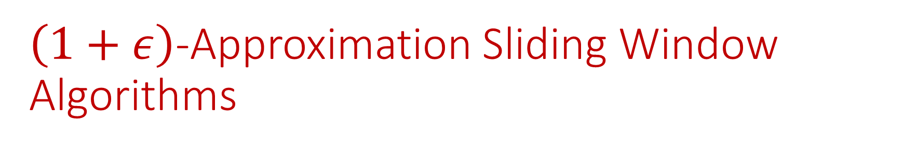

$\left(1+ε\right)$-Approximation Sliding Window Algorithms
Space $\tilde{O}\left(\frac{1}{ε^{2}}\log{n}\right)$ algorithm for $F_{0}$ [BravermanGrigorescuLangWoodruffZhou18]
Space $\tilde{O}\left(\frac{1}{ε^{2}}\log^{3}{n}\right)$algorithm for $L_{2}$-heavy hitters [BravermanGrigorescuLangWoodruffZhou18]

Slide 28
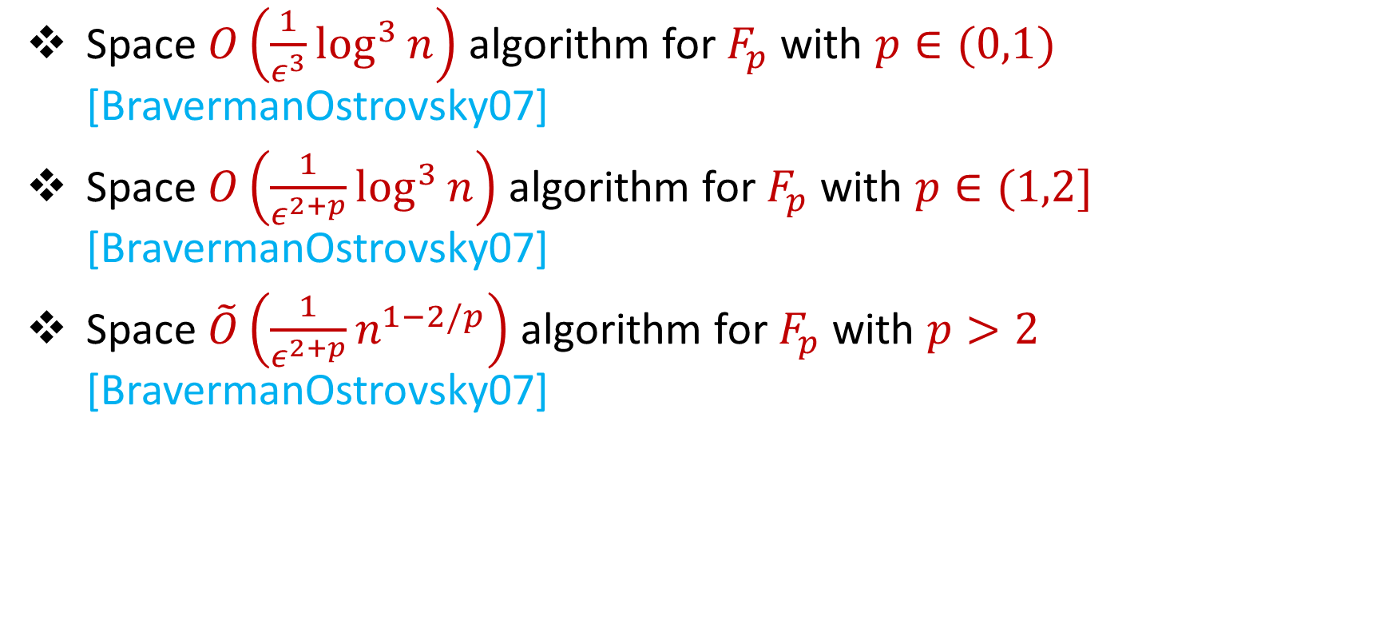
$\left(1+ε\right)$-Approximation Sliding Window Algorithms
Space $O\left(\frac{1}{ε^{3}}\log^{3}{n}\right)$ algorithm for $F_{p}$ with $p∈(0,1)$ [BravermanOstrovsky07]
Space $O\left(\frac{1}{ε^{2+p}}\log^{3}{n}\right)$ algorithm for $F_{p}$ with $p∈(1,2]$ [BravermanOstrovsky07]
Space $\tilde{O}\left(\frac{1}{ε^{2+p}}n^{1−2/p}\right)$ algorithm for $F_{p}$ with $p>2$ [BravermanOstrovsky07]
“A general framework that loses* nothing in $n$ and only $\frac{1}{ε}$ ”

Slide 29
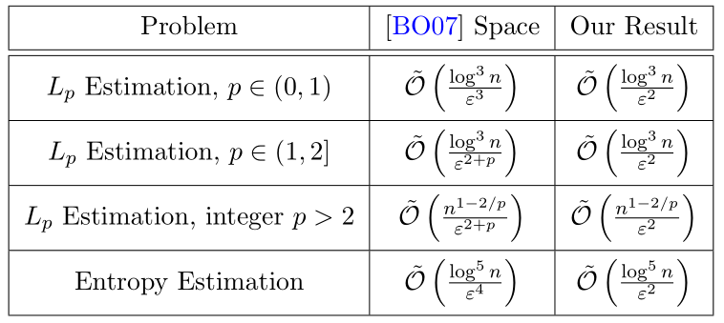

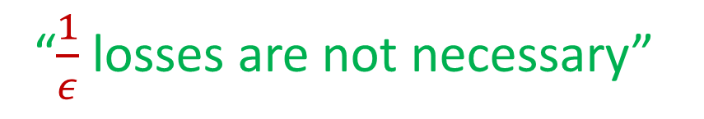

Our Results: $\left(1+ε\right)$-Approximation Sliding Window Algorithms
Space $\tilde{O}\left(\frac{1}{ε^{2}}\log^{3}{n}\right)$ algorithm for $F_{p}$ with $p∈\left(0, 2\right]$
“$\frac{1}{ε}$ losses are not necessary”

Slide 30

Questions?
Format
Part 1: Background
Part 2: Frameworks
Part 3: Difference Estimators

Slide 31
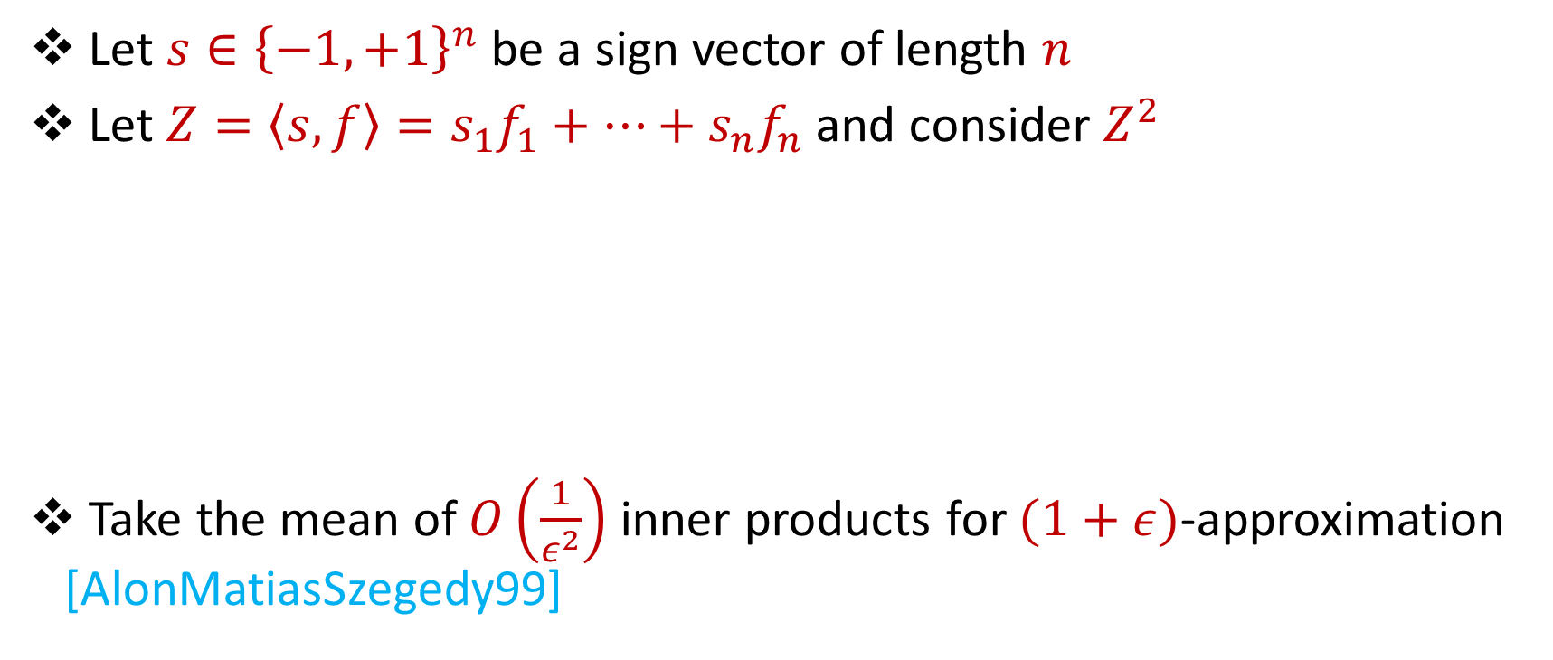

AMS $F_{2}$Algorithm
Let $s∈{\left\{−1,+1\right\}}^{n}$ be a sign vector of length $n$
Let $Z=\left\langle s,f\right\rangle =s_{1}f_{1}+…+s_{n}f_{n}$ and consider $Z^{2}$
Take the mean of $O\left(\frac{1}{ε^{2}}\right)$ inner products for $(1+ε)$-approximation [AlonMatiasSzegedy99]
$E\left[Z^{2}\right]=$ $\sum_{i,j}{E\left[s_{i}s_{j}f_{i}f_{j}\right]}=f_{1}^{2}+…+f_{n}^{2}$
$Var\left[Z^{2}\right]≤$ $\sum_{i,j}{E\left[s_{i}s_{j}s_{k}s_{l}f_{i}f_{j}f_{k}f_{l}\right]}≤2F_{2}^{2}$

Slide 32
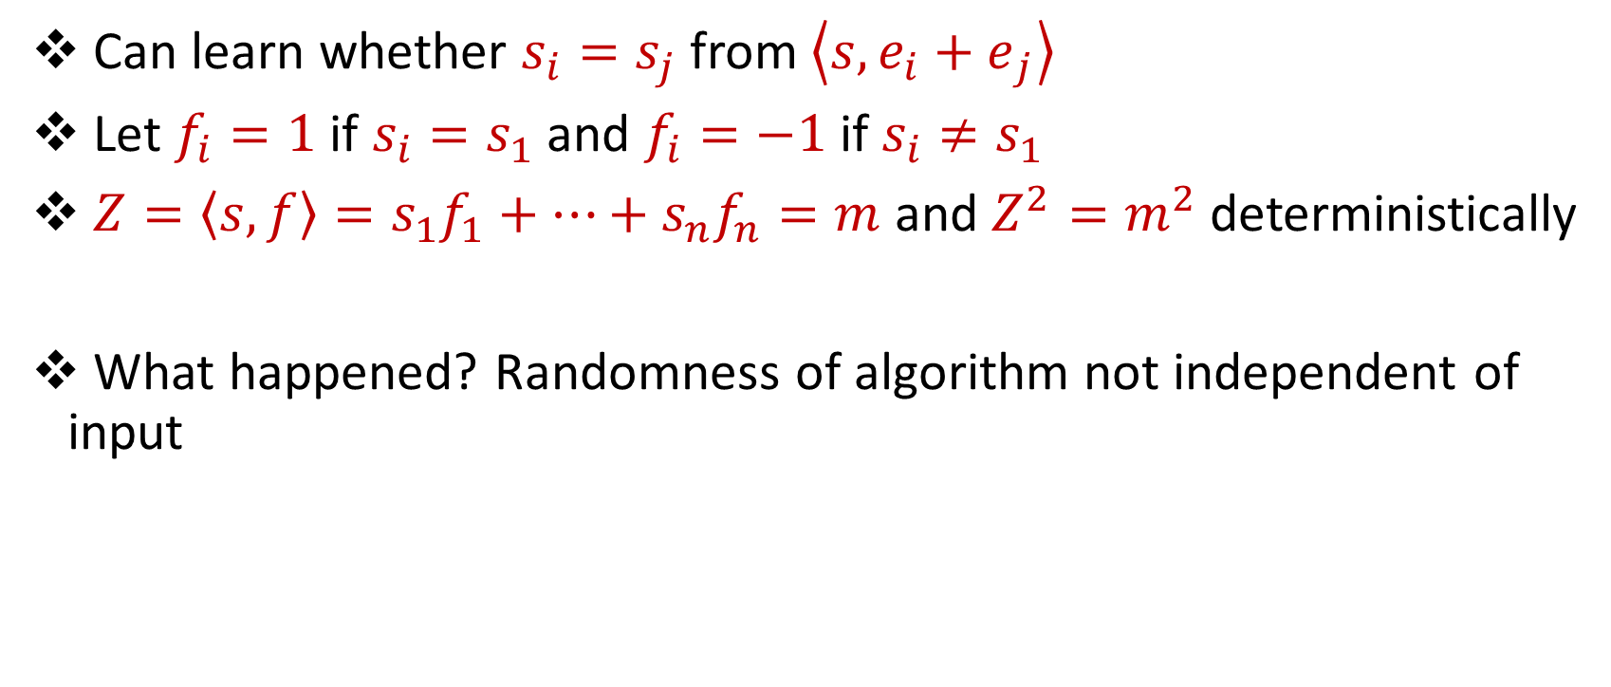
“Attack” on AMS
Can learn whether $s_{i}=s_{j}$ from $\left\langle s,{e_{i}+e}_{j}\right\rangle$
Let $f_{i}=1$ if $s_{i}=s_{1}$ and $f_{i}=−1$ if $s_{i}≠s_{1}$
$Z=\left\langle s,f\right\rangle =s_{1}f_{1}+…+s_{n}f_{n}=m$ and $Z^{2}=m^{2}$ deterministically
What happened? Randomness of algorithm not independent of input

Slide 33
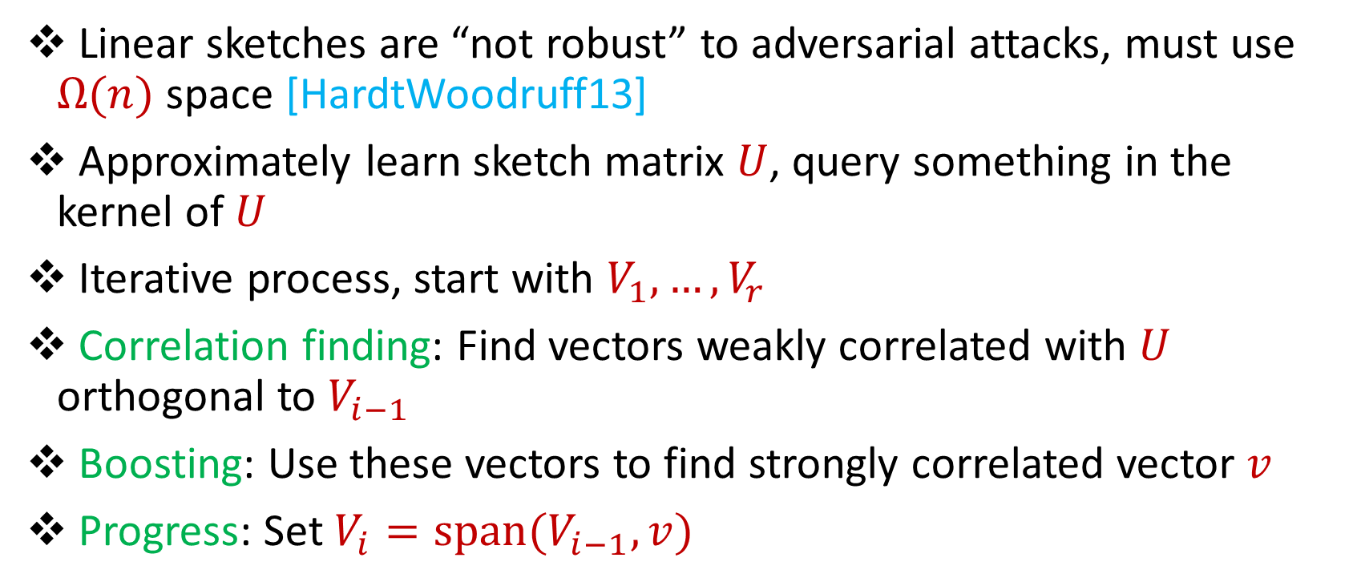
Reconstruction Attack on Linear Sketches
Linear sketches are “not robust” to adversarial attacks, must use $Ω(n)$ space [HardtWoodruff13]
Approximately learn sketch matrix $U$, query something in the kernel of $U$
Iterative process, start with $V_{1},…,V_{r}$
Correlation finding: Find vectors weakly correlated with $U$ orthogonal to $V_{i−1}$
Boosting: Use these vectors to find strongly correlated vector $v$
Progress: Set $V_{i}=span(V_{i−1},v)$

Slide 34
Insertion-Only Streams
Key: Deletions are needed to perform this attack
Similar lower bounds for the sliding window model [DatarGionisIndykMotwani02]
Assume insertion-only updates
How do the previous results work?

Slide 35
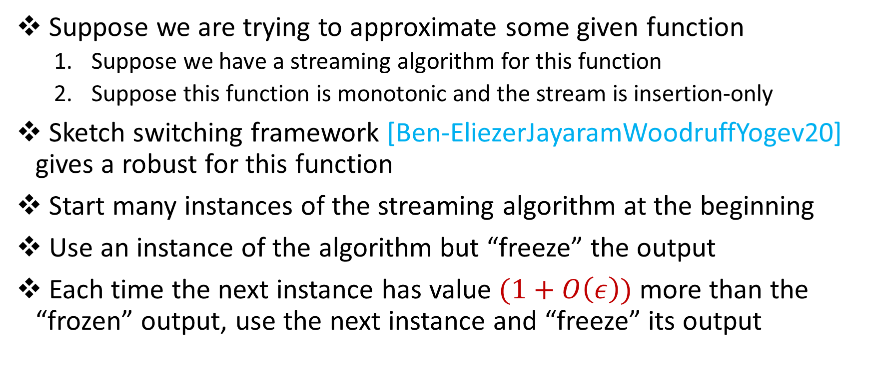
Robust Algorithms
Suppose we are trying to approximate some given function
Suppose we have a streaming algorithm for this function
Suppose this function is monotonic and the stream is insertion-only
Sketch switching framework [Ben-EliezerJayaramWoodruffYogev20] gives a robust for this function
Start many instances of the streaming algorithm at the beginning
Use an instance of the algorithm but “freeze” the output
Each time the next instance has value $(1+O\left(ε\right))$ more than the “frozen” output, use the next instance and “freeze” its output

Slide 36

Robust Algorithms
Start many instances of the streaming algorithm at the beginning
Use an instance of the algorithm but “freeze” the output
Each time the next instance has value $(1+O\left(ε\right))$ more than the “frozen” output, use the next instance and “freeze” its output
1
Example: Number of ones in the stream (2-approximation)
1
1
1
1

Slide 37
Robust Algorithms
Start many instances of the streaming algorithm at the beginning
Use an instance of the algorithm but “freeze” the output
Each time the next instance has value $(1+O\left(ε\right))$ more than the “frozen” output, use the next instance and “freeze” its output
1 0
Example: Number of ones in the stream (2-approximation)
1
1
1
1

Slide 38

Robust Algorithms
Start many instances of the streaming algorithm at the beginning
Use an instance of the algorithm but “freeze” the output
Each time the next instance has value $(1+O\left(ε\right))$ more than the “frozen” output, use the next instance and “freeze” its output
1 0 1
Example: Number of ones in the stream (2-approximation)
1
2
2
2

Slide 39
Robust Algorithms
Start many instances of the streaming algorithm at the beginning
Use an instance of the algorithm but “freeze” the output
Each time the next instance has value $(1+O\left(ε\right))$ more than the “frozen” output, use the next instance and “freeze” its output
1 0 1
Example: Number of ones in the stream (2-approximation)
1
2
2
2

Slide 40
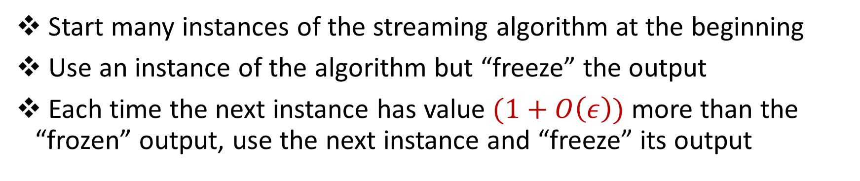
Robust Algorithms
Start many instances of the streaming algorithm at the beginning
Use an instance of the algorithm but “freeze” the output
Each time the next instance has value $(1+O\left(ε\right))$ more than the “frozen” output, use the next instance and “freeze” its output
1 0 1 1
Example: Number of ones in the stream (2-approximation)
1
2
3
3

Slide 41
Robust Algorithms
Start many instances of the streaming algorithm at the beginning
Use an instance of the algorithm but “freeze” the output
Each time the next instance has value $(1+O\left(ε\right))$ more than the “frozen” output, use the next instance and “freeze” its output
1 0 1 1 1
Example: Number of ones in the stream (2-approximation)
1
2
4
4

Slide 42
Robust Algorithms
Start many instances of the streaming algorithm at the beginning
Use an instance of the algorithm but “freeze” the output
Each time the next instance has value $(1+O\left(ε\right))$ more than the “frozen” output, use the next instance and “freeze” its output
1 0 1 1 1
Example: Number of ones in the stream (2-approximation)
1
2
4
4

Slide 43
Robust Algorithms
Start many instances of the streaming algorithm at the beginning
Use an instance of the algorithm but “freeze” the output
Each time the next instance has value $(1+O\left(ε\right))$ more than the “frozen” output, use the next instance and “freeze” its output
1 0 1 1 1 0 0 1 1 0 1
Example: Number of ones in the stream (2-approximation)
Number of ones stream is at least 4 and at most 8
4 is a good approximation
1
2
4
7

Slide 44
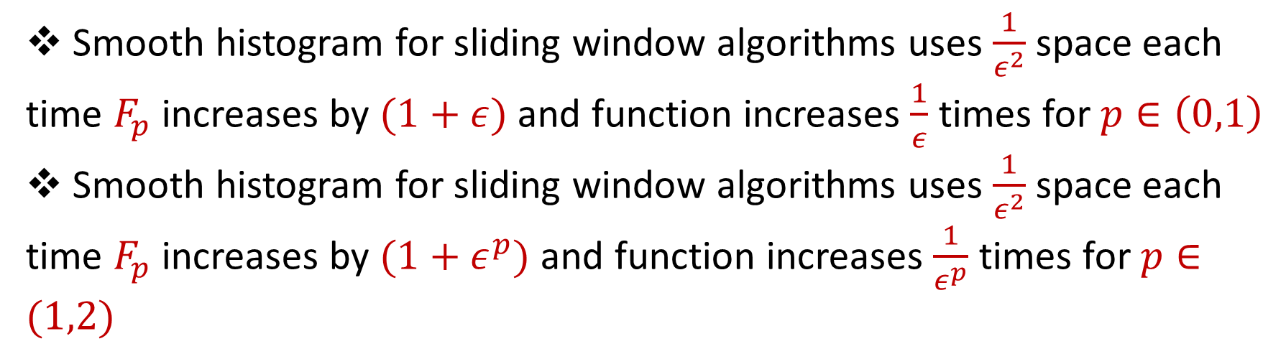
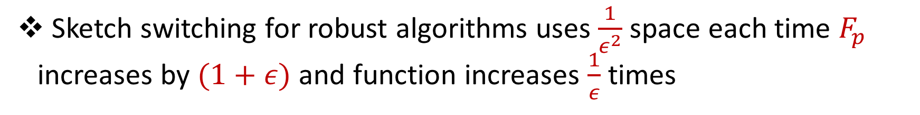
Summary
Sketch switching for robust algorithms uses $\frac{1}{ε^{2}}$ space each time $F_{p}$ increases by $(1+ε)$ and function increases $\frac{1}{ε}$ times
Smooth histogram for sliding window algorithms uses $\frac{1}{ε^{2}}$ space each time $F_{p}$ increases by $(1+ε)$ and function increases $\frac{1}{ε}$ times for $p∈\left(0,1\right)$
Smooth histogram for sliding window algorithms uses $\frac{1}{ε^{2}}$ space each time $F_{p}$ increases by $(1+ε^{p})$ and function increases $\frac{1}{ε^{p}}$ times for $p∈(1,2)$

Slide 45





Intuition
Do we really need to pay $\frac{1}{ε^{2}}$ space each time $F_{p}$ increases by $(1+ε)$?
$F_{p}(u)$
$$u$$
$$u+v$$
$F_{p}(u+v)$

Slide 46


Intuition
Do we really need to pay $\frac{1}{ε^{2}}$ space each time $F_{p}$ increases by $(1+ε)$?
$F_{p}(u)$
$$u$$
$$u+v$$
$F_{p}(u+v)$
$$v$$

Slide 47
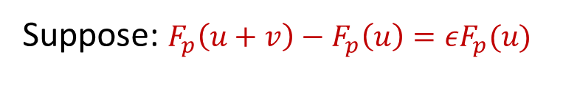

Intuition
Do we really need to pay $\frac{1}{ε^{2}}$ space each time $F_{p}$ increases by $(1+ε)$?
$F_{p}(u)$
$$u$$
$$u+v$$
Suppose: $F_{p}\left(u+v\right)−F_{p}\left(u\right)=εF_{p}(u)$
$F_{p}(u+v)$
$$v$$

Slide 48

Intuition
Do we really need to pay $\frac{1}{ε^{2}}$ space each time $F_{p}$ increases by $(1+ε)$?
Only need constant factor approximation to $εF_{p}(u)$
Only need constant factor approximation to $F_{p}\left(u+v\right)−F_{p}\left(u\right)$
$F_{p}(u)$
$$u$$
$$u+v$$
Suppose: $F_{p}\left(u+v\right)−F_{p}\left(u\right)=εF_{p}(u)$
$F_{p}(u+v)$
$$v$$

Slide 49


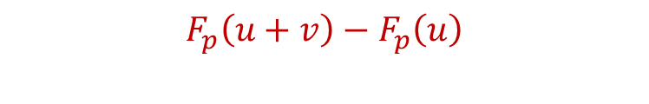




Sketch Stitching
Suppose we want $F_{p}\left(u+v\right)$
$F_{p}\left(u+v\right)={(F}_{p}\left(u+v\right)−F_{p}\left(u\right))+F_{p}(u)$
$F_{p}(u+v)$
$F_{p}(u)$
$$F_{p}\left(u+v\right)−F_{p}\left(u\right)$$
$$u$$
$$v$$
$$u+v$$

Slide 50





Sketch Stitching
Suppose we want $F_{p}\left(u+v\right)$ and $v=v_{1}+v_{2}+…+v_{b}$
$F_{p}(u+v)$
$F_{p}(u)$
$$F_{p}\left(u+v\right)−F_{p}\left(u\right)$$
$$u$$
$$v_{1}$$
$$v_{2}$$
$$v$$
$$u+v$$

Slide 51

Sketch Stitching
Suppose we want $F_{p}\left(u+v\right)$ and $v=v_{1}+v_{2}+…+v_{b}$
$F_{p}\left(u+v\right)={(F}_{p}\left(u+v\right)−F_{p}\left(u\right))+F_{p}(u)$
$F_{p}(u+v)$
$F_{p}(u)$
$$F_{p}\left(u+v\right)−F_{p}\left(u\right)$$
$$u$$
$$v_{1}$$
$$v_{2}$$
$$v$$
$$u+v$$

Slide 52
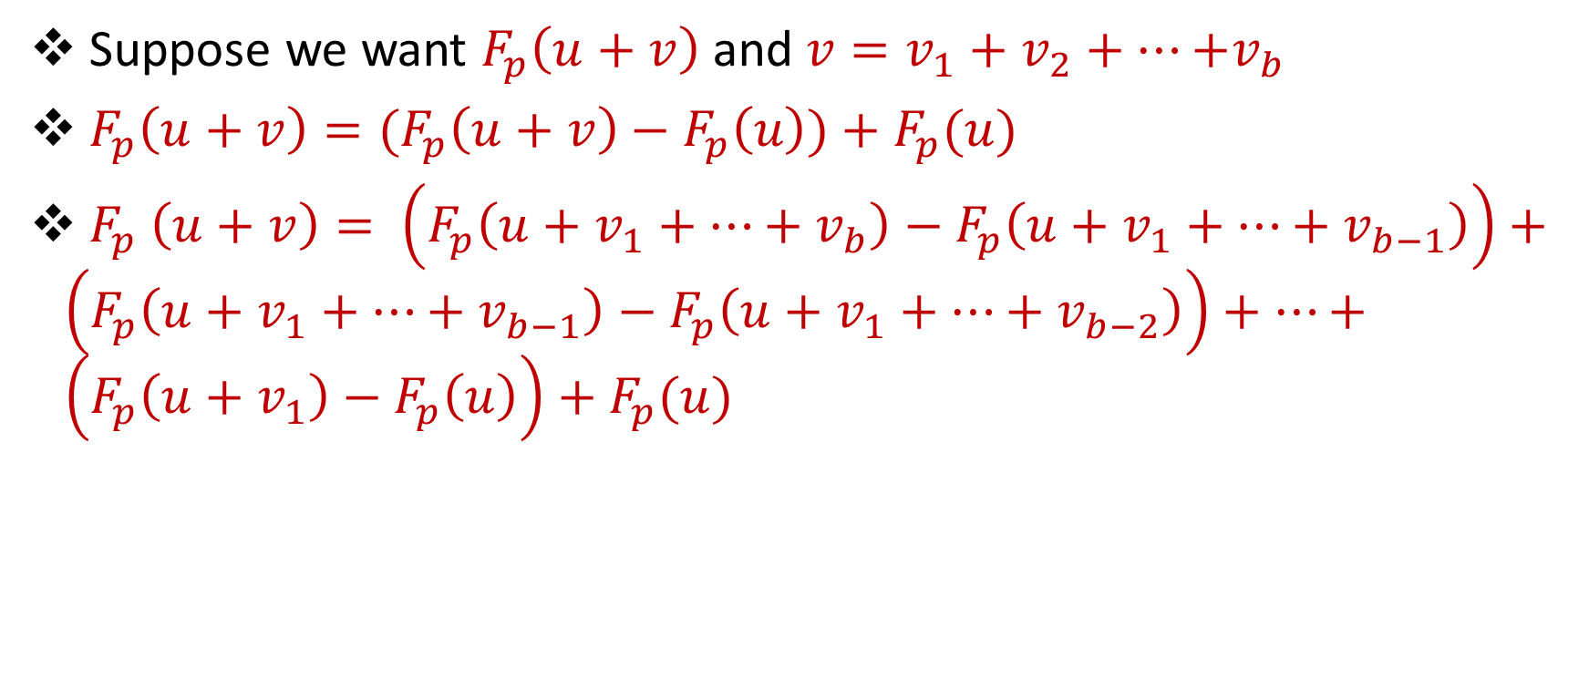
Sketch Stitching
Suppose we want $F_{p}\left(u+v\right)$ and $v=v_{1}+v_{2}+…{+v}_{b}$
$F_{p}\left(u+v\right)={(F}_{p}\left(u+v\right)−F_{p}\left(u\right))+F_{p}(u)$
$F_{p} \left(u+v\right)= \left(F_{p}\left(u+v_{1}+…+v_{b}\right)−F_{p}\left(u+v_{1}+…+v_{b−1}\right)\right)+\left(F_{p}\left(u+v_{1}+…+v_{b−1}\right)−F_{p}\left(u+v_{1}+…+v_{b−2}\right)\right)+…+\left(F_{p}\left(u+v_{1}\right)−F_{p}\left(u\right)\right)$ $+ F_{p}(u)$

Slide 53
Sketch Stitching
Suppose we want $F_{p}\left(u+v\right)$ and $v=v_{1}+v_{2}+…{+v}_{b}$
$F_{p}\left(u+v\right)={(F}_{p}\left(u+v\right)−F_{p}\left(u\right))+F_{p}(u)$
$F_{p} \left(u+v\right)= \left(F_{p}\left(u+v_{1}+…+v_{b}\right)−F_{p}\left(u+v_{1}+…+v_{b−1}\right)\right)+\left(F_{p}\left(u+v_{1}+…+v_{b−1}\right)−F_{p}\left(u+v_{1}+…+v_{b−2}\right)\right)+…+\left(F_{p}\left(u+v_{1}\right)−F_{p}\left(u\right)\right)$ $+ F_{p}(u)$

Slide 54


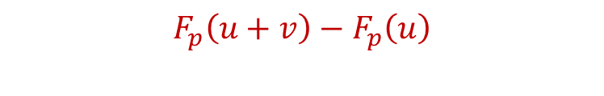
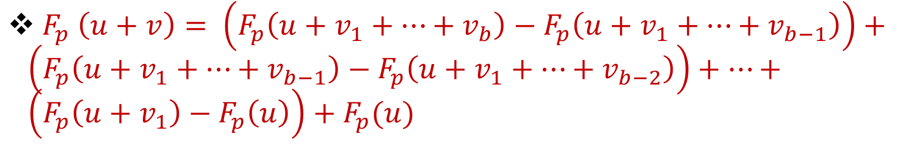






Sketch Stitching
$F_{p} \left(u+v\right)= \left(F_{p}\left(u+v_{1}+…+v_{b}\right)−F_{p}\left(u+v_{1}+…+v_{b−1}\right)\right)+\left(F_{p}\left(u+v_{1}+…+v_{b−1}\right)−F_{p}\left(u+v_{1}+…+v_{b−2}\right)\right)+…+\left(F_{p}\left(u+v_{1}\right)−F_{p}\left(u\right)\right)$ $+ F_{p}(u)$
$F_{p}(u+v)$
$F_{p}(u)$
$$F_{p}\left(u+v\right)−F_{p}\left(u\right)$$
$$u$$
$$v_{1}$$
$$v_{2}$$
$$v_{b}$$
$$u+v$$
$$v$$

Slide 55
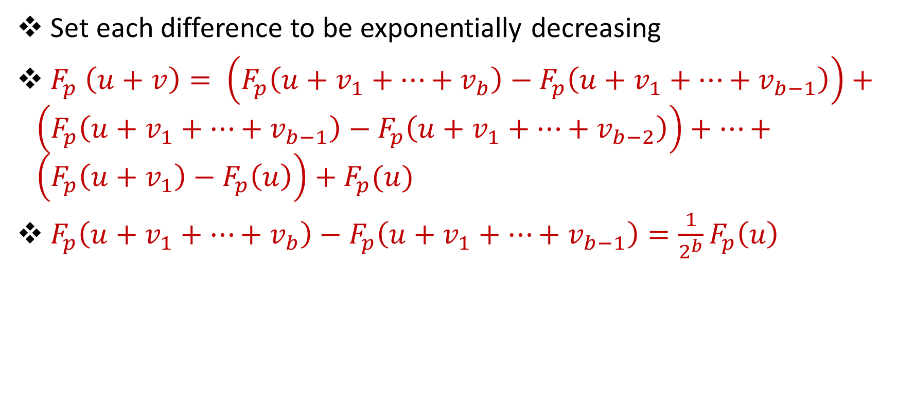
Granularity Change
Set each difference to be exponentially decreasing
$F_{p} \left(u+v\right)= \left(F_{p}\left(u+v_{1}+…+v_{b}\right)−F_{p}\left(u+v_{1}+…+v_{b−1}\right)\right)+\left(F_{p}\left(u+v_{1}+…+v_{b−1}\right)−F_{p}\left(u+v_{1}+…+v_{b−2}\right)\right)+…+\left(F_{p}\left(u+v_{1}\right)−F_{p}\left(u\right)\right)+F_{p}(u)$
$F_{p}\left(u+v_{1}+…+v_{b}\right)−F_{p}\left(u+v_{1}+…+v_{b−1}\right)=\frac{1}{2^{b}}F_{p}\left(u\right)$

Slide 56

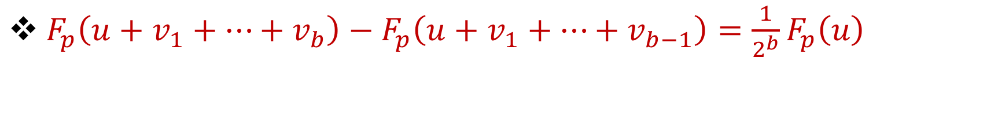




Granularity Change
$F_{p}\left(u+v_{1}+…+v_{b}\right)−F_{p}\left(u+v_{1}+…+v_{b−1}\right)=\frac{1}{2^{b}}F_{p}\left(u\right)$
$F_{p}(u+v)$
$F_{p}(u)$
$$F_{p}\left(u+v\right)−F_{p}\left(u\right)$$
$$u$$
$$v_{1}$$
$$v_{2}$$
$$v_{b}$$
$$u+v$$
$$v$$
Previously:

Slide 57

Granularity Change
$F_{p}\left(u+v_{1}+…+v_{b}\right)−F_{p}\left(u+v_{1}+…+v_{b−1}\right)=\frac{1}{2^{b}}F_{p}\left(u\right)$
Just need $2^{b}ε$-approximation to $F_{p}\left(u+v_{1}+…+v_{b}\right)−F_{p}\left(u+v_{1}+…+v_{b−1}\right)$
Intuition: pay $\frac{1}{ε^{2}}$ for $\left(1+ε\right)$-approximation
Hope is to use space $\frac{1}{{2^{2b}ε}^{2}}$ for $2^{b}ε$-approximation

Slide 58






Framework
Algorithms simultaneously running for each granularity
Want space $\frac{1}{{2^{2b}ε}^{2}}$ for granularity $\frac{1}{2^{b}}F_{p}\left(u\right)$
Need $2^{b}$ instances for granularity $\frac{1}{2^{b}}F_{p}\left(u\right)$
Total space $∑\frac{1}{{2^{b}ε}^{2}}=\frac{1}{ε^{2}}$
$$u$$
$$v_{1}$$
$$u$$
$$v_{1}$$
$$v_{2}$$

Slide 59
Questions?
Format
Part 1: Background
Part 2: Framework
Part 3: Difference Estimators

Slide 60



Difference Estimator
If $F_{p}\left(u+v\right)−F_{p}\left(u\right)=2^{b}εF_{p}(u)$, does there exist algorithm that approximates the difference with space $\frac{1}{{2^{2b}ε}^{2}}$?
Definition: $F_{p}\left(u+v\right)−F_{p}\left(u\right)=γF_{p}(u)$, output an estimate to the difference with additive approximation $εF_{p}(u)$

Slide 61

Difference Estimator
Definition: $F_{p}\left(u+v\right)−F_{p}\left(u\right)=γF_{p}(u)$, output an estimate to the difference with additive approximation $εF_{p}(u)$
$F$ is generally non-linear
Ex: $F_{p}\left(u+v\right)=\frac{1}{ε^{4}}$, $F_{p}\left(u+v\right)−F_{p}\left(u\right)=1$
$\left(1+ε\right)$ approximations to $F_{p}\left(u+v\right)$ and $F_{p}\left(u\right)$ give multiplicative approximation to the difference but use space $\frac{1}{ε^{2}}$
Constant factor approximations to $F_{p}\left(u+v\right)$ and $F_{p}\left(u\right)$ do not give additive approximation $εF_{p}(u)$ to the difference

Slide 62

Our Results: Difference Estimators
Space $\tilde{O}\left(\frac{γ}{ε^{2}}\log{n}\right)$ algorithm for $F_{0}$
Space $\tilde{O}\left(\frac{γ^{2/p}}{ε^{2}}\log{n}\right)$ algorithm for $F_{p}$ with $p∈\left(0, 2\right]$
Space $\tilde{O}\left(\frac{γ}{ε^{2}}n^{1−2/p}\right)$ algorithm for $F_{p}$ with integer $p>2$

Slide 63


$F_{2}$ Difference Estimator
Definition: $F_{2}\left(u+v\right)−F_{2}\left(u\right)=γF_{2}(u)$, output an estimate to the difference with additive approximation $εF_{2}(u)$
$F_{2}\left(u+v\right)−F_{2}\left(u\right)=\left\langle u+v,u+v\right\rangle −\left\langle u,u\right\rangle =2\left\langle u,v\right\rangle +{\left\langle v,v\right\rangle }^{2}$
Inner product property: $\left(1+ε\right)$ -approximations to ${\left\|u\right\|}_{2}$ and ${\left\|v\right\|}_{2}$ gives an ${ε\left\|u\right\|}_{2}{\left\|v\right\|}_{2}$ additive approximation to $\left\langle u,v\right\rangle$
$γF_{2}\left(u\right)≥{\left\langle v,v\right\rangle }^{2}$ implies $2\left\langle u,v\right\rangle ≤2{\left\|u\right\|}_{2}{\left\|v\right\|}_{2}≤2\sqrt{γ}$ $F_{2}\left(u\right)$
Just need $\frac{ε}{\sqrt{γ}}$ multiplicative approximation: $\tilde{O}\left(\frac{γ}{ε^{2}}\log{n}\right)$ space!

Slide 64


$F_{2}$ Difference Estimator
Difference estimator: Maintain $\left(1+\frac{ε}{\sqrt{γ}}\right)$-approximations to $F_{2}\left(u+v\right)$ and $F_{2}\left(u\right)$ using AMS sketch
For $F_{2}\left(u+v\right)−F_{2}\left(u\right)=γF_{2}(u)$, difference of the outputs is an additive approximation $εF_{2}(u)$ to $F_{2}\left(u+v\right)−F_{2}\left(u\right)$
Space $\tilde{O}\left(\frac{γ}{ε^{2}}\log{n}\right)$ algorithm for difference estimator

Slide 65




Challenges for $F_{p}$ Difference Estimators
$F_{p}$ difference estimator: Use $p$-stable random variables for $p≤2$?
$\left\langle Z_{p},f\right\rangle$ where $Z_{p}$ has entries drawn from $p$-stable distribution
$$p\left(x\right)∼\frac{1}{1+{\left|x\right|}^{p+1}}$$

Slide 66


$F_{p}$ Difference Estimators
$Z=median\left\langle Z_{p},f\right\rangle$
How to analyze median of each estimate of $F_{p}\left(u+v\right)−F_{p}\left(u\right)$?
Use Li’s geometric mean algorithm [Li08]
Take the geometric mean of 3 inner products $\left\langle Z_{p},f\right\rangle$
Take the average of $O\left(\frac{1}{ε^{2}}\right)$ geometric means

Slide 67

$F_{p}$ Difference Estimators
Difference estimator: Maintain $\left(1+\frac{ε}{γ^{1/p}}\right)$-approximations to $F_{p}\left(u+v\right)$ and $F_{p}\left(u\right)$ using Li’s geometric mean estimator
$A\left(u+v\right)−A\left(u\right)∼{\left\langle p_{1},v\right\rangle }^{p/3}{\left\langle p_{2},v\right\rangle }^{p/3}$ ${\left\langle p_{3},v\right\rangle }^{p/3}+$
Each summand has ${\left\langle p_{1},v\right\rangle }^{p/3}$ term, which has much smaller variance
${\left\langle p_{1},u\right\rangle }^{p/3}{\left\langle p_{2},v\right\rangle }^{p/3}$ ${\left\langle p_{1},v\right\rangle }^{p/3}+$
${\left\langle p_{1},u\right\rangle }^{p/3}{\left\langle p_{2},u\right\rangle }^{p/3}$ ${\left\langle p_{1},v\right\rangle }^{p/3}+…$

Slide 68
New Framework for Streaming Algorithms
Tight bounds for sliding window algorithms
Sketch Stitching
Granularity Change
Difference Estimators
Tight bounds for adversarially robust streaming algorithms

Slide 69


Future Directions
Additional applications of difference estimators, e.g., general $p>2$?
Uses of differential privacy for adaptive data analysis
Algorithms robust to white-box adversaries?

Slide 70

Challenges for $F_{p}$ Difference Estimators
$F_{p}$ difference estimator: Generalization of inner products for $p>2$?
Variance can be much larger!
Use heavy-hitter algorithm to explicitly track “heavy” elements
Use $L_{2}$ sampling algorithm with $n^{1−2/p}$ buckets to sample “light” elements

Slide 71

General Challenges
Use known structural results from chaining to remove $\log{n}$ factor in difference estimator
Avoids typical Chernoff + union bound argument by considering the expected supremum of a process, “strong tracking”
Use suffix argument to remove $\log{n}$ factor in framework
Adaptation to sliding window model

Slide 72


Robust vs. Sliding Window

Slide 73
Literature
Tight Bounds for Adversarially Robust Streams and Sliding Windows via Difference Estimators, David P. Woodruff, Samson Zhou (FOCS 2021)
Adversarial Robustness of Streaming Algorithms through Importance Sampling, Vladimir Braverman, Avinatan Hassidim, Yossi Matias, Mariano Schain, Sandeep Silwal, Samson Zhou (NeurIPS 2021)
The White-Box Adversarial Data Stream Model, Miklós Ajtai, Vladimir Braverman, T.S. Jayram, Sandeep Silwal, Alec Sun, David P. Woodruff, Samson Zhou (PODS 2022)
Notes:
Let’s start by breaking down each of the terms in the title. To understand the sliding window model, we first have to understand the streaming model of computation, in which elements of an underlying data set S, arrive sequentially and the goal is to evaluate or approximate some given function on this dataset, using space sublinear in S. In the sliding window model, only the W most recent updates form the underlying data set

Slide 74


Sliding Window Algorithms
Suppose we are trying to approximate some given function
Suppose we have a streaming algorithm for this function
Suppose this function is “smooth”: If $f\left(B\right)$ is a “good” approximation to $f\left(A\right)$, then $f\left(B∪C\right)$ will always be a “good” approximation to $f\left(A∪C\right)$.
Smooth histogram framework [BravermanOstrovsky07] gives a sliding window algorithm for this function

Slide 75
Smooth Histogram
Suppose we are trying to approximate some given function
Smooth histogram framework [BO07] gives a sliding window algorithm for this function
Start a new instance of the streaming algorithm (along with existing instances) each time a new element arrives
Each time there are three instances that report “close” values, delete the middle one
Use different checkpoints to “sandwich” the sliding window

Slide 76
Smooth Histogram
Start a new instance of the streaming algorithm (along with existing instances) each time a new element arrives
Each time there are three instances that report “close” values, delete the middle one
Use different checkpoints to “sandwich” the sliding window
1
Example: Number of ones in sliding window (2-approximation)
1

Slide 77
Smooth Histogram
Start a new instance of the streaming algorithm (along with existing instances) each time a new element arrives
Each time there are three instances that report “close” values, delete the middle one
Use different checkpoints to “sandwich” the sliding window
1 0
Example: Number of ones in sliding window (2-approximation)
1
0

Slide 78
Smooth Histogram
Start a new instance of the streaming algorithm (along with existing instances) each time a new element arrives
Each time there are three instances that report “close” values, delete the middle one
Use different checkpoints to “sandwich” the sliding window
1 0 1
Example: Number of ones in sliding window (2-approximation)
2
1
1

Slide 79
Smooth Histogram
Start a new instance of the streaming algorithm (along with existing instances) each time a new element arrives
Each time there are three instances that report “close” values, delete the middle one
Use different checkpoints to “sandwich” the sliding window
1 0 1
Example: Number of ones in sliding window (2-approximation)
2
1

Slide 80
Smooth Histogram
Start a new instance of the streaming algorithm (along with existing instances) each time a new element arrives
Each time there are three instances that report “close” values, delete the middle one
Use different checkpoints to “sandwich” the sliding window
1 0 1
Example: Number of ones in sliding window (2-approximation)
2
1

Slide 81
Smooth Histogram
Start a new instance of the streaming algorithm (along with existing instances) each time a new element arrives
Each time there are three instances that report “close” values, delete the middle one
Use different checkpoints to “sandwich” the sliding window
1 0 1 1
Example: Number of ones in sliding window (2-approximation)
3
2
1

Slide 82
Smooth Histogram
Start a new instance of the streaming algorithm (along with existing instances) each time a new element arrives
Each time there are three instances that report “close” values, delete the middle one
Use different checkpoints to “sandwich” the sliding window
1 0 1 1 1
Example: Number of ones in sliding window (2-approximation)
4
3
2
1

Slide 83
Smooth Histogram
Start a new instance of the streaming algorithm (along with existing instances) each time a new element arrives
Each time there are three instances that report “close” values, delete the middle one
Use different checkpoints to “sandwich” the sliding window
1 0 1 1 1
Example: Number of ones in sliding window (2-approximation)
4
2
1

Slide 84
Smooth Histogram
Start a new instance of the streaming algorithm (along with existing instances) each time a new element arrives
Each time there are three instances that report “close” values, delete the middle one
Use different checkpoints to “sandwich” the sliding window
1 0 1 1 1 0 0 1 1 0 1
Example: Number of ones in sliding window (2-approximation)
7
4
2
1

Slide 85
Smooth Histogram
Start a new instance of the streaming algorithm (along with existing instances) each time a new element arrives
Each time there are three instances that report “close” values, delete the middle one
Use different checkpoints to “sandwich” the sliding window
1 0 1 1 1 0 0 1 1 0 1
Example: Number of ones in sliding window (2-approximation)
Number of ones in sliding window is at least 4 and at most 7
4 is a good approximation
7
4
2
1

Slide 86

Granularity Change
Set each difference to be exponentially decreasing
$F_{p} \left(u+v\right)= \left(F_{p}\left(u+v_{1}+…+v_{b}\right)−F_{p}\left(u+v_{1}+…+v_{b−1}\right)\right)+\left(F_{p}\left(u+v_{1}+…+v_{b−1}\right)−F_{p}\left(u+v_{1}+…+v_{b−2}\right)\right)+…+\left(F_{p}\left(u+v_{1}\right)−F_{p}\left(u\right)\right)+F_{p}(u)$
$F_{p}\left(u+v_{1}+…+v_{b}\right)−F_{p}\left(u+v_{1}+…+v_{b−1}\right)=\frac{1}{2^{b}}F_{p}\left(u\right)$
Just need $2^{b}ε$-approximation to $F_{p}\left(u+v_{1}+…+v_{b}\right)−F_{p}\left(u+v_{1}+…+v_{b−1}\right)$
Hope is to use space $\frac{1}{{2^{2b}ε}^{2}}$

